Slide 1
Introduction to Linear Models Lab

Slide 2
Example 1:
Suppose that you are interested in purchasing a Porsche sports car. Porscheprices dataset contains a random sample of 30 cars of Porsche sports car, and three variables were observed which are price, age and mileage of each car.
Identify the response variable and the explanatory variable(s).

Slide 3
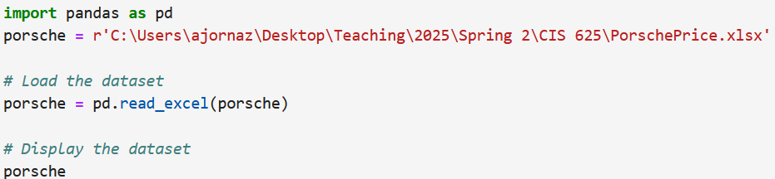
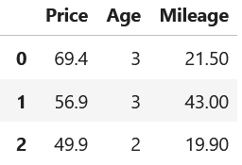
Import the dataset, and print out.

Slide 4
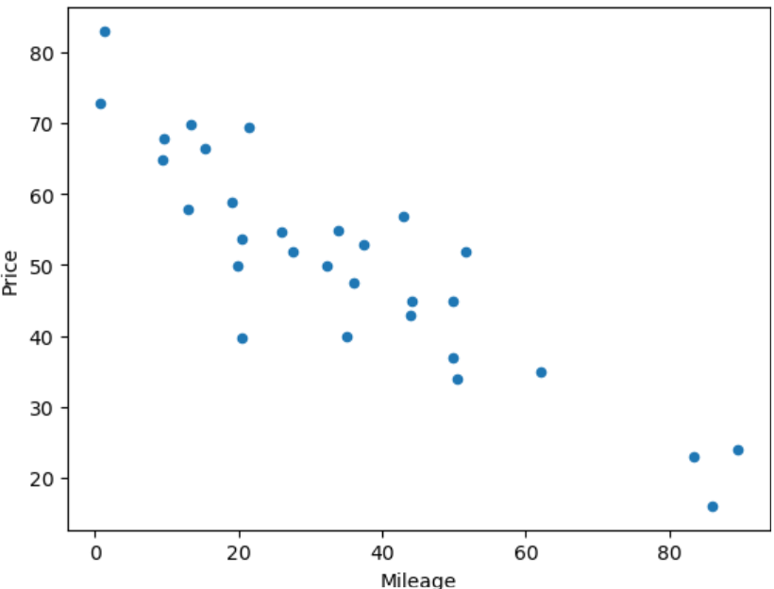
Figure 1 Scatterplots of mileage and price
Using a scatterplot, determine the relationship between the price and mileage.

Slide 5
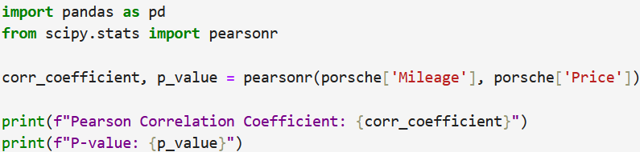
Calculate the correlation between the price and mileage.
There is a strong negative linear relationship between the price and mileage.

Slide 6
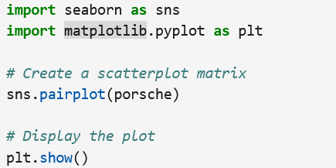
Present the scatterplot matrix of the dataset.

Slide 7
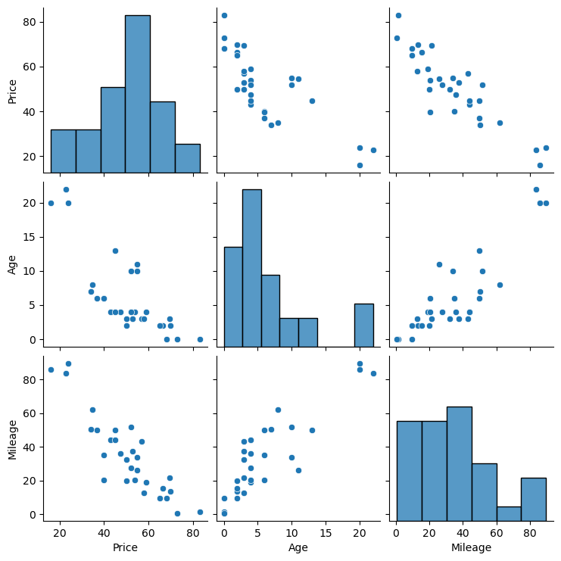
Figure 2 The scatterplot matrix of the Porsche dataset

Slide 8
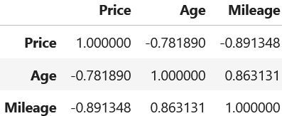
Calculate the correlation matrix of the dataset.

Slide 9
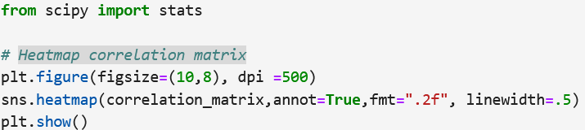
Present the heatmap correlation matrix of the dataset.

Slide 10
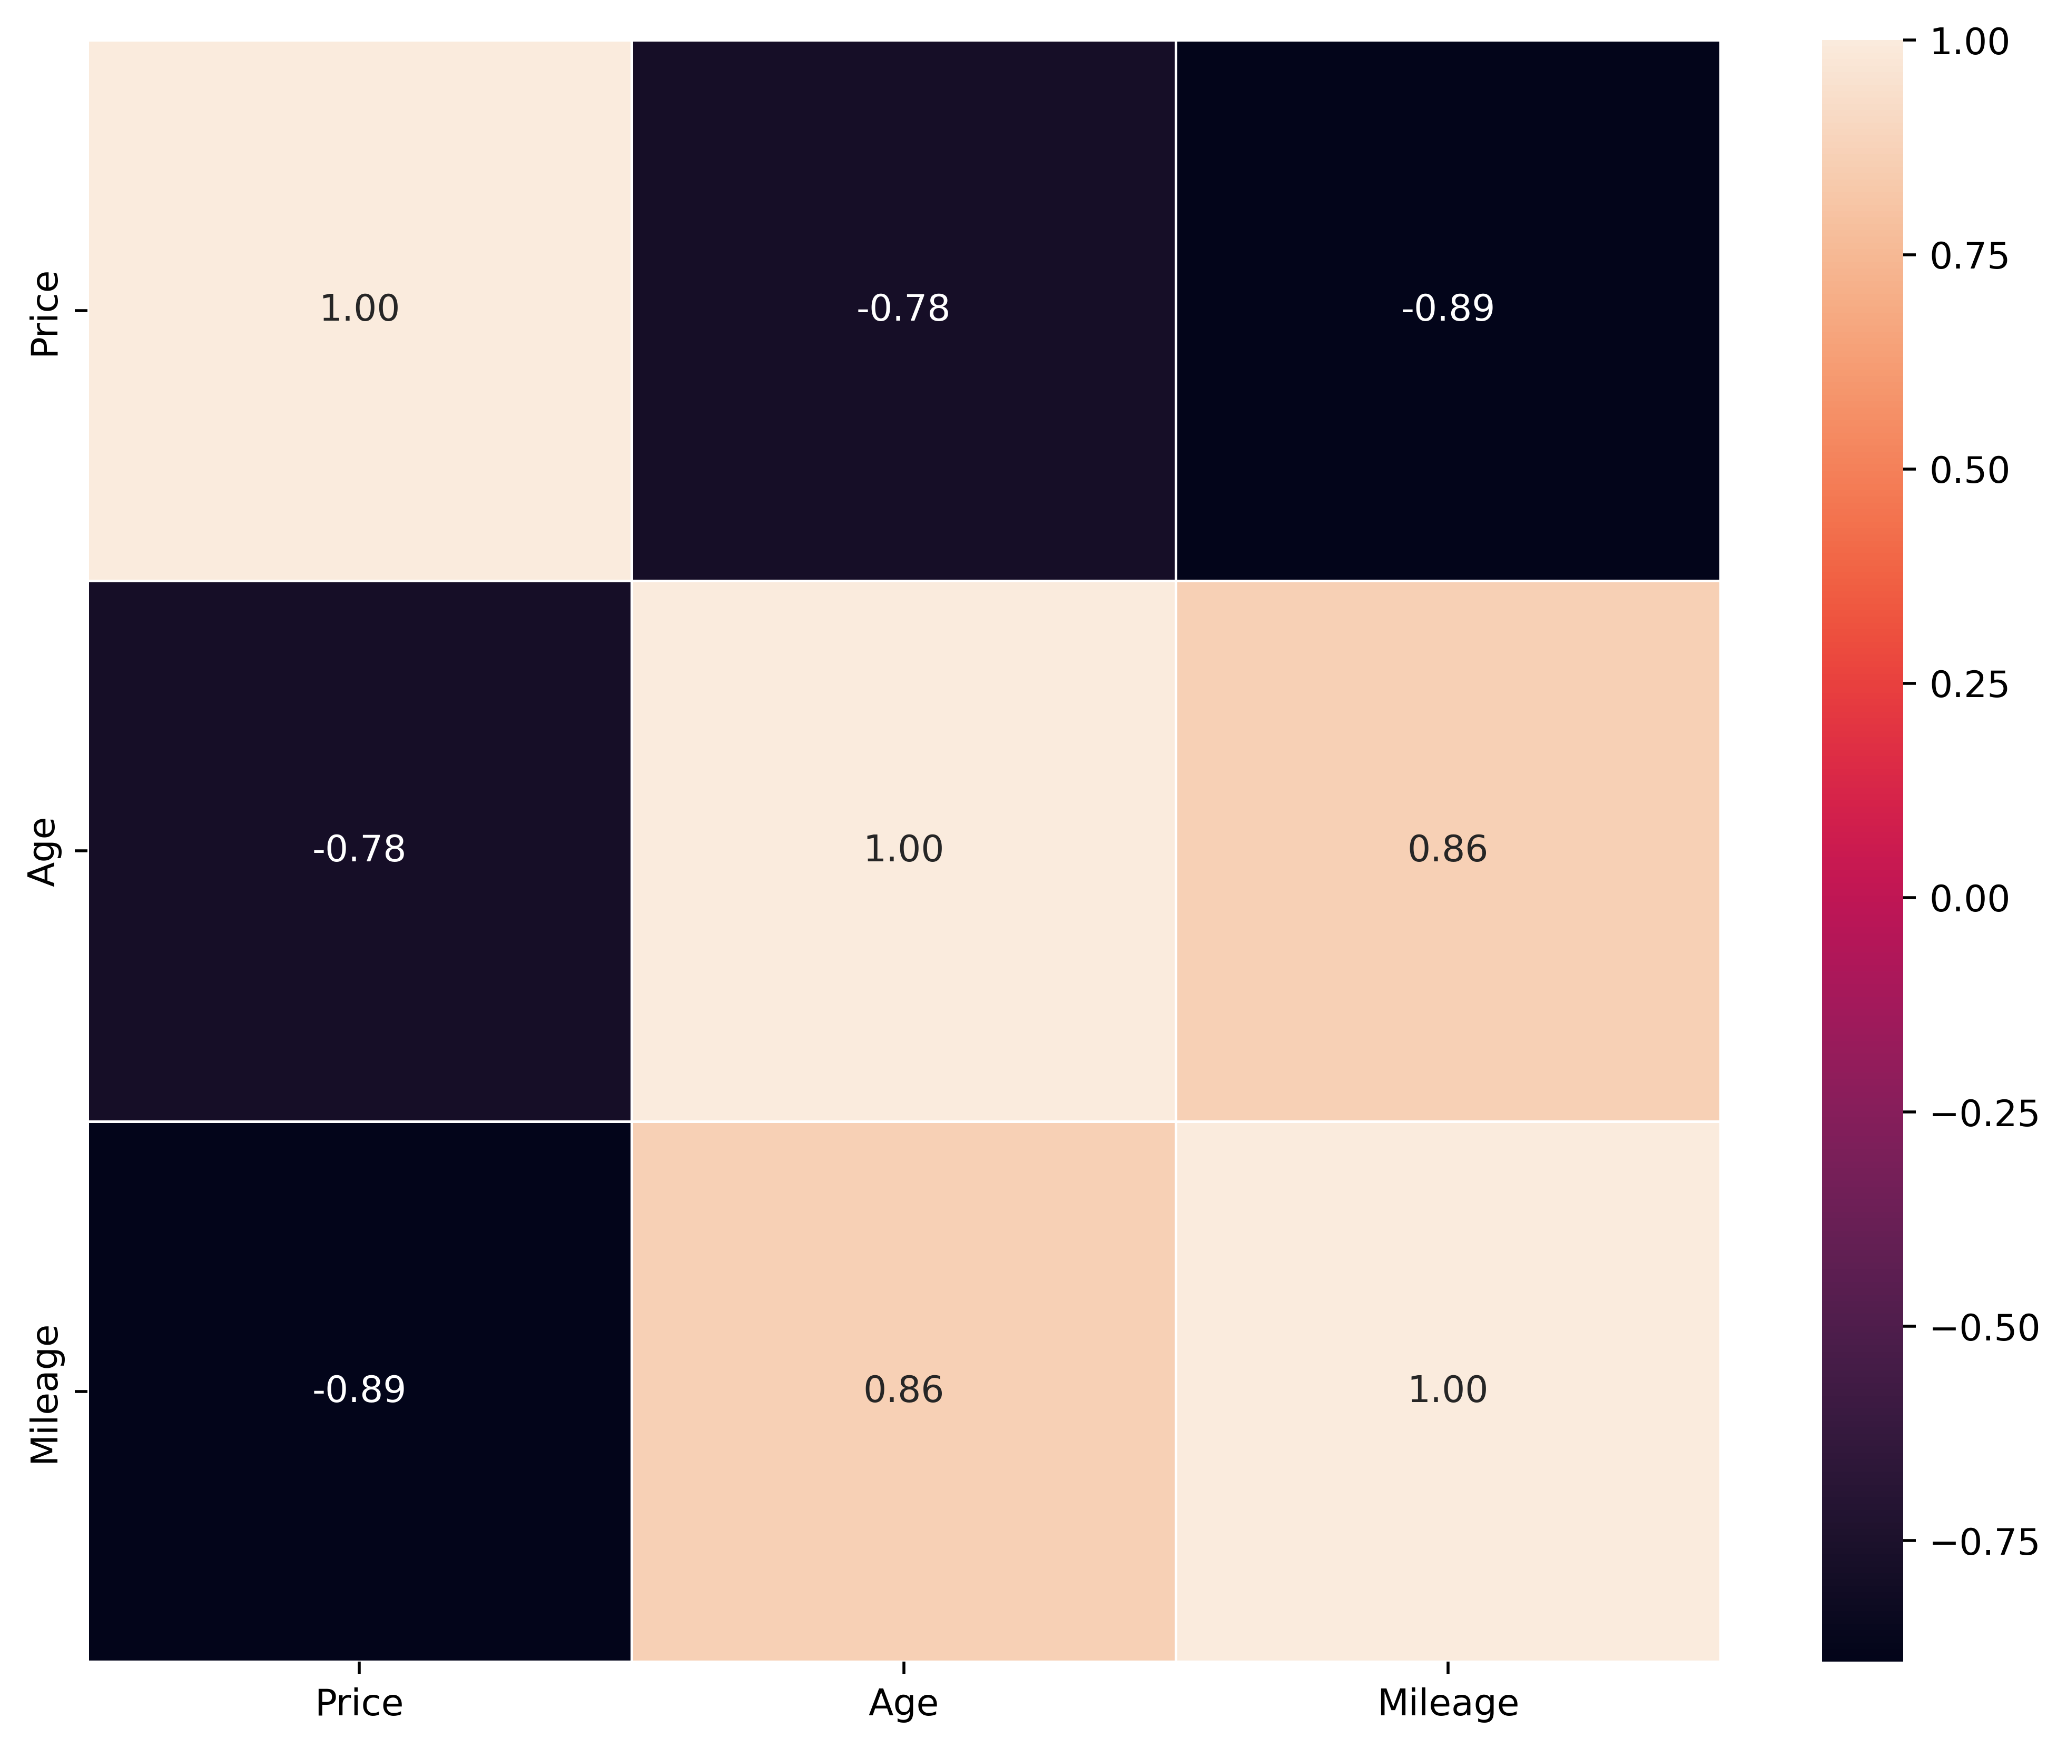
Figure 3 The heatmap correlation matrix of the Porsche dataset

Slide 11
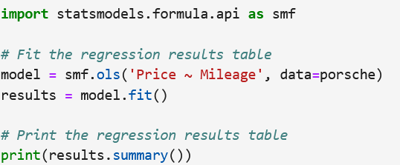
Fit a simple regression model for price and mileage.

Slide 12
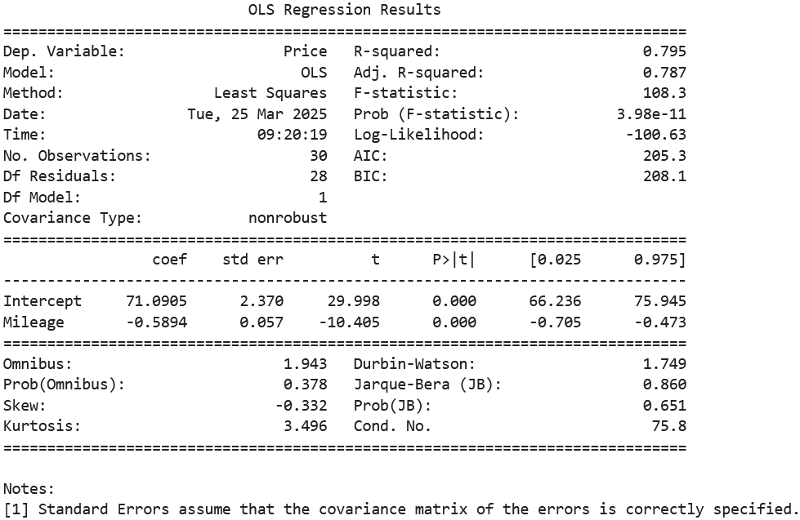
Table 1 The simple linear regression analysis results

Slide 13
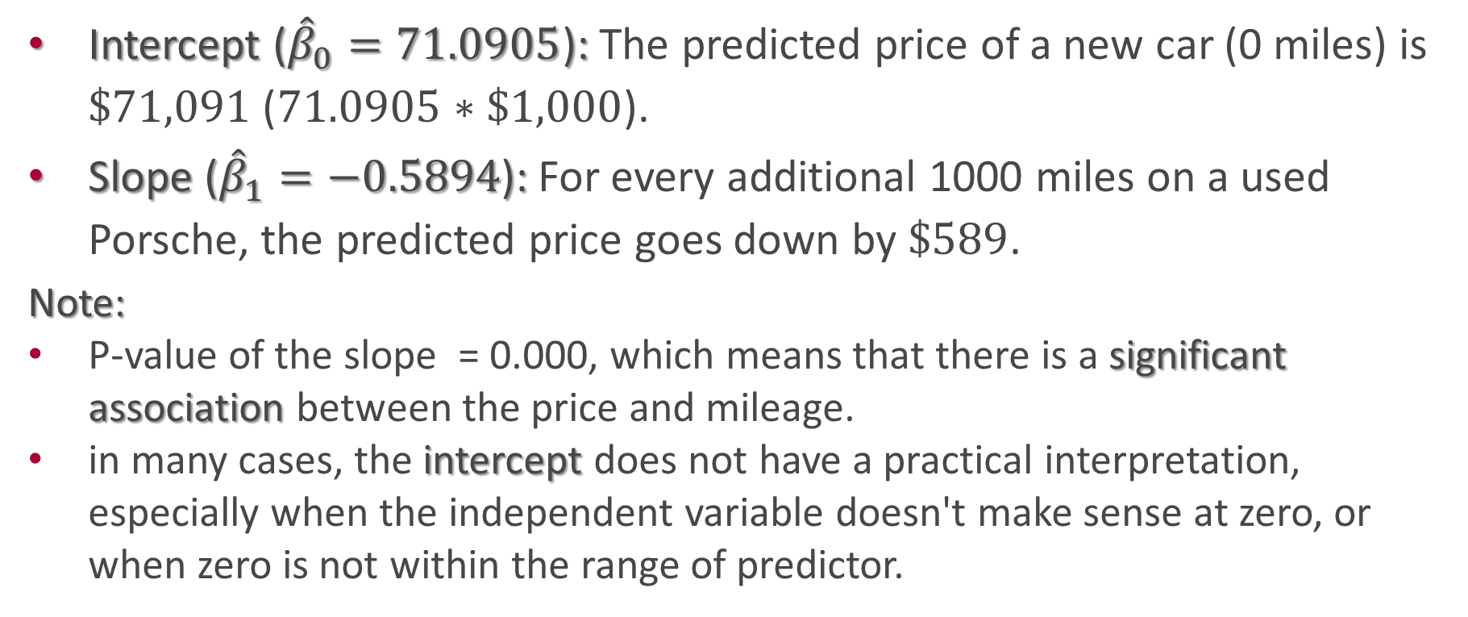
Interpret the regression model coefficients.
Intercept (${\hat{β}}_{0}=71.0905$): The predicted price of a new car (0 miles) is $\$71,091$ ($71.0905∗\$1,000$).
Slope (${\hat{β}}_{1}=−0.5894$): For every additional 1000 miles on a used Porsche, the predicted price goes down by $\$589$.
Note:
P-value of the slope = 0.000, which means that there is a significant association between the price and mileage.
in many cases, the intercept does not have a practical interpretation, especially when the independent variable doesn't make sense at zero, or when zero is not within the range of predictor.

Slide 14
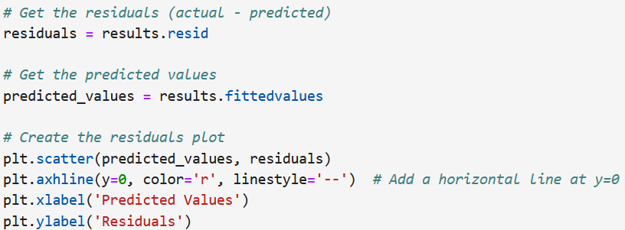
Check the assumption of the regression model.

Slide 15
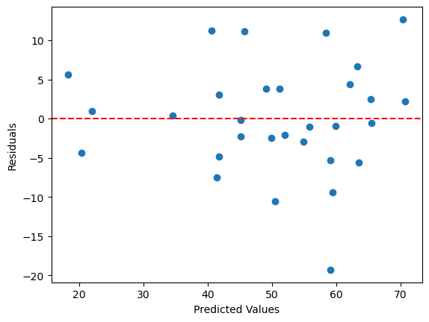
Figure 4 The residual plot of the model
We observe that the linearity and independence assumptions are valid, but the equal variance assumption is not.

Slide 16
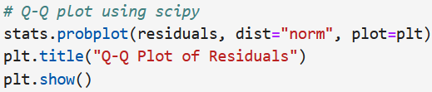
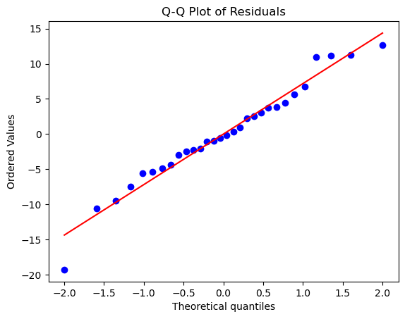
Figure 5 The qq-plot of the model's residuals
In the qq-plot, most of the residuals lie on the reference line, so we can say that the normality

Slide 17
Check for the outliers.
There are several ways to do that, we can use residuals plot, standardized residuals plot, qq-plot, boxplot, leverage vs. normalized residuals plot, or Cook's distance test.
The residuals Plot (figure 4) and qq-plot (figure 5) show that there is a possibility of an outlier.

Slide 18
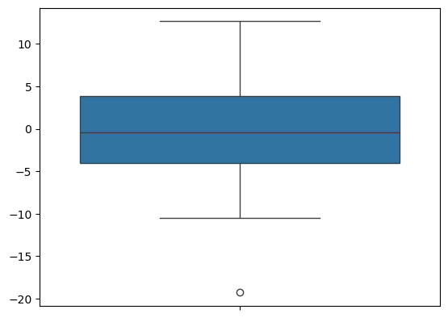
Figure 6 Boxplot of the residuals
There is a possible outlier.

Slide 19
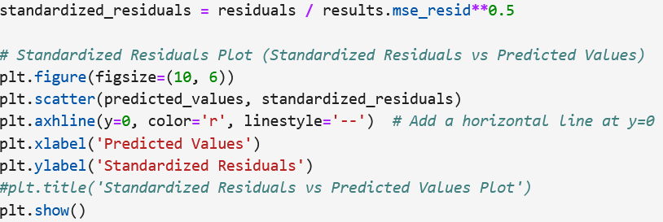
Standardized residuals plot

Slide 20
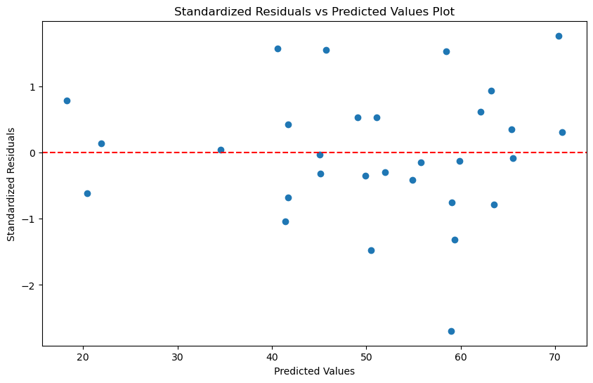
Figure 7 Standardized residuals plot
A standardized residual greater than 3 or smaller than -3 is an outlier, so we can say that there is no potential outlier.

Slide 21
Leverage vs. normalized residuals plot

Slide 22
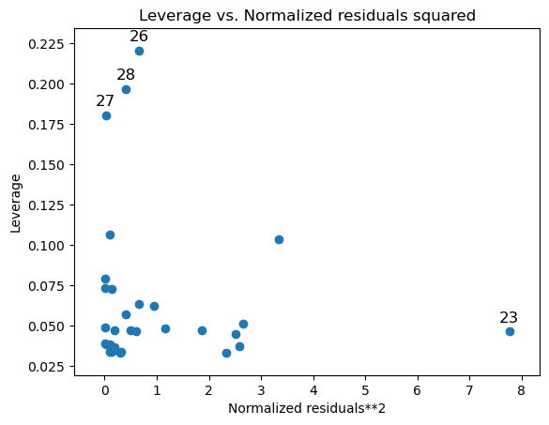
Figure 8 Leverage vs. normalized residuals plot
The observation number 23 can by an outlier for the price (y); whereas, the observations 26, 27, and 28 can be outliers for (x).

Slide 23
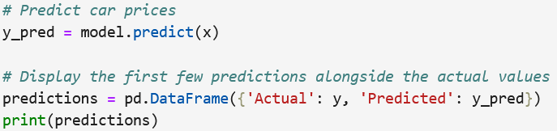

Find the predicted values using the obtained model.

Slide 24
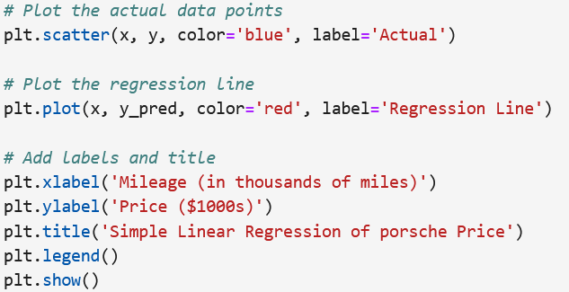
Create a scatterplot with the best fit line (predicted values).

Slide 25
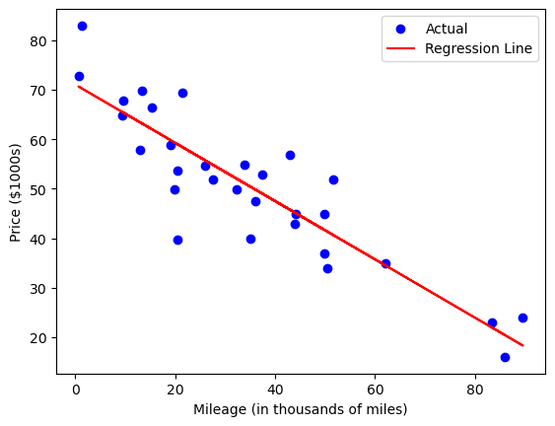
Figure 9 The scatterplot with the best fit line

Slide 26
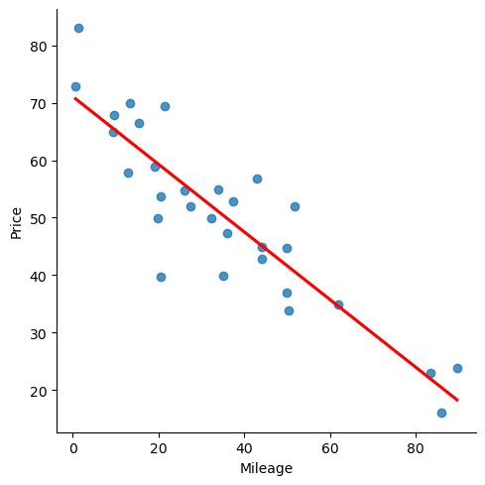
Note: here is an easy way to plot a scatterplot with the best fit line.

Slide 27
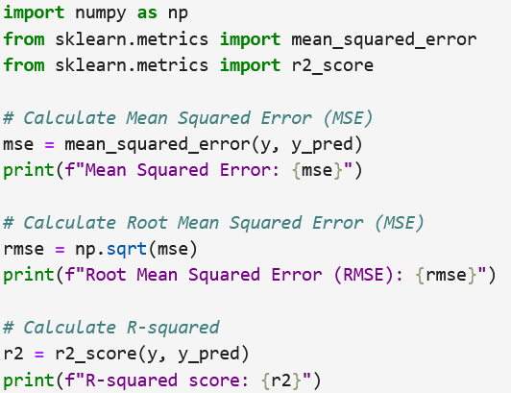
Evaluate the model. Calculate the MSE, RMSE, and $R^{2}$. Interpret $R^{2}$.

Slide 28

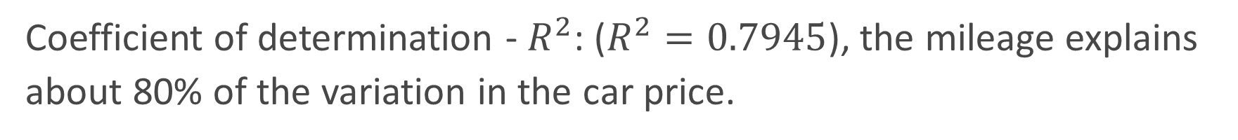
Coefficient of determination - $R^{2}$: ($R^{2}=0.7945$), the mileage explains about 80% of the variation in the car price.

Slide 29
Practice:
Rerun this example by using car age as a predictor.
Which model fits the data better?

